Slide 1
Technology Layer

Slide 2
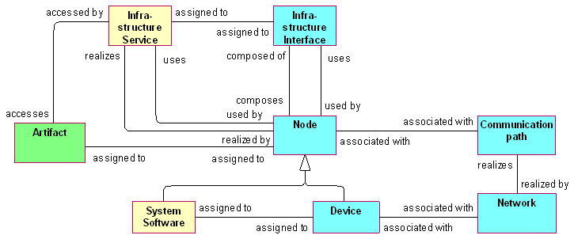
Technology Layer Metamodel

Slide 3
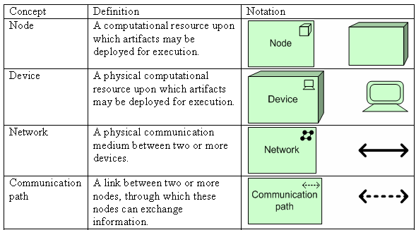
Technology Layer Concepts

Slide 4
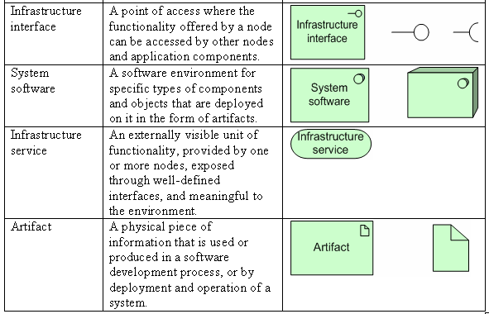
Technology Layer Concepts

Slide 5
Structural Concepts
The main structural concept for the technology layer is the node. This concept is used to model structural entities in this layer
Nodes come in two flavors: device and system software.
A device models a physical computational resource, upon which artifacts may be deployed for execution.
System software is classified as a behavioral concept, since it defines what a device “does”. Typically, a node will consist of a number of sub-nodes; for example, a device such as a server and system software to model the operating system.

Slide 6

Node
A node is defined as a computational resource upon which artifacts may be deployed for execution.
Nodes are, for example, used to model application servers, database servers, or client workstations. They can consist of sub-nodes representing physical devices and execution environments for artifacts.

Slide 7
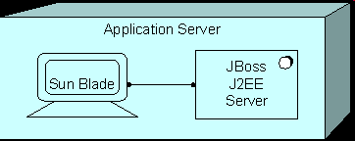
Node Example
In the model below, we see an Application Server node, which consists of a Sun Blade device and a JBoss J2EE Server application.

Slide 8

Device
A device is defined as a physical computational resource upon which artifacts may be deployed for execution.
It is typically used to model hardware systems such as mainframes, PCs, or routers. Usually, they are part of a node together with system software. Devices may be composite; i.e., consist of sub-devices.

Slide 9

Device Example
In the model below, we see a device IBM Systems z to which DB2 system software is assigned.

Slide 10

Infrastructure Interface
An infrastructure interface is defined as a point of access where the functionality offered by a node can be accessed by other nodes and application components
An infrastructure interface specifies how the infrastructure services of a node can be accessed by other nodes (provided interface), or which functionality the node requires from its environment (required interface).

Slide 11
Infrastructure Interface
In a sense, an infrastructure interface specifies a kind of contract that a component realizing this interface must fulfill. This may include, for example, parameters, protocols used, pre- and post-conditions, and data formats.
An infrastructure interface may be part of a node through composition (not shown in the standard notation), which means that these interfaces are provided or required by that node, and can be used by other nodes.
An infrastructure service can be assigned to an infrastructure interface, which exposes the service to the environment

Slide 12
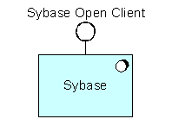
Infrastructure Interface Example
In the model below, we see a Sybase Open Client infrastructure interface exposed, which is part of the Sybase system software.

Slide 13
Network
A network is defined as a physical communication medium between two or more devices.
A network represents the physical communication infrastructure.
The most basic network is a single link between two devices. A network has properties such as bandwidth and latency.

Slide 14

Network
A network connects two or more devices. A network realizes one or more communication paths.
A network can consist of sub-networks.

Slide 15

Network Example
In the model below, a 100 Mb/s LAN network connects a mainframe and PC device.

Slide 16
Communication Path
A communication path is defined as a link between two or more nodes, through which these nodes can exchange information.
A communication path is used to model the logical communication relations between nodes. It is realized by one or more networks, which represent the physical communication links.

Slide 17

Communication Path
The communication properties (e.g., bandwidth, latency) of a communication path are usually aggregated from these underlying networks.
A communication path connects two or more nodes. A communication path is realized by one or more networks.

Slide 18

Communication Path Example
In the model below, we see a communication path “message queuing” between an Application Server and a Client.

Slide 19
Behavioral Concepts
An infrastructure service describes the externally visible and accessible functionality of a node.
System software represents the software environment for specific types of components and data objects that are deployed on it in the form of artifacts.

Slide 20
Infrastructure Service
An infrastructure service is defined as an externally visible unit of functionality, provided by one or more nodes, exposed through well-defined interfaces, and meaningful to the environment.
An infrastructure service exposes the functionality of a node to its environment.
This functionality is accessed through one or more infrastructure interfaces. It may require, use, and produce artifacts.

Slide 21

Infrastructure Service
Typical infrastructure services may, for example, include messaging, storage, naming, and directory services. It may access artifacts; e.g., a file containing a message
An infrastructure service may be used by application components or nodes.
An infrastructure service is realized by a node.
An infrastructure service is exposed by a node by assigning it to its infrastructure interfaces. An infrastructure service may access artifacts.

Slide 22
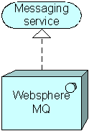
Infrastructure Service Example
In the model below, we see a Messaging service realized by Websphere MQ system software.

Slide 23

System Software
System software represents a software environment for specific types of components and objects that are deployed on it in the form of artifacts.
This can be, for example, an operating system, a J2EE application server, a CORBA ORB, a database system, a workflow engine, or COTS software such as ERP or CRM packages.

Slide 24

System Software Example
In the model below, we see DB2 system software assigned to (deployed on) an OS/390 mainframe device.

Slide 25
Informational Concepts

Slide 26
Artifact
An artifact is defined as a physical piece of information that is used or produced in a software development process, or by deployment and operation of a system.
An artifact represents a concrete element in the physical world. It is typically used to model (software) products such as source files, executables, scripts, database tables, messages, documents, specifications, and model files. An instance (copy) of an artifact can be deployed on a node.

Slide 27

Artifact
An application component may be realized by one or more artifacts. A data object may be realized by one or more artifacts.
An artifact may be assigned to (i.e., deployed on) a node. Thus, the two typical ways to use the artifact concept are as an execution component or as a data file.

Slide 28

Artifact Example
In the example below, we see an artifact Risk management EJB, which represents a deployable unit of code, assigned to (deployed on) an application server.

